Slide 1
Project: Image Analysis

Slide 2
Pytorch

Slide 3
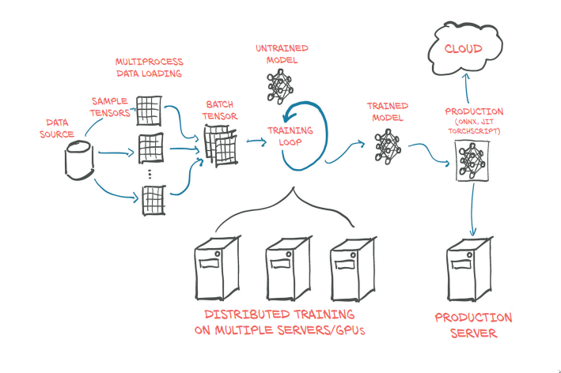
Deep Learning with Pytorch Pytorch Tutorials

Slide 4
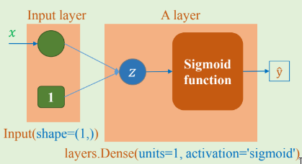
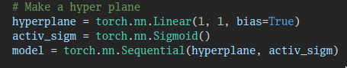
Build Neural Network

Slide 5
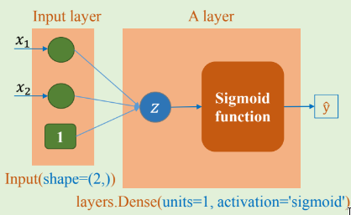
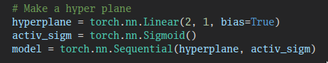
Build Neural Network

Slide 6
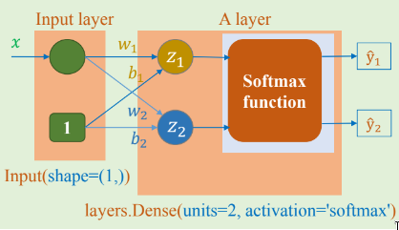
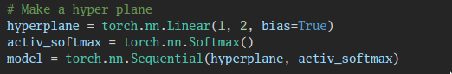
Build Neural Network

Slide 7
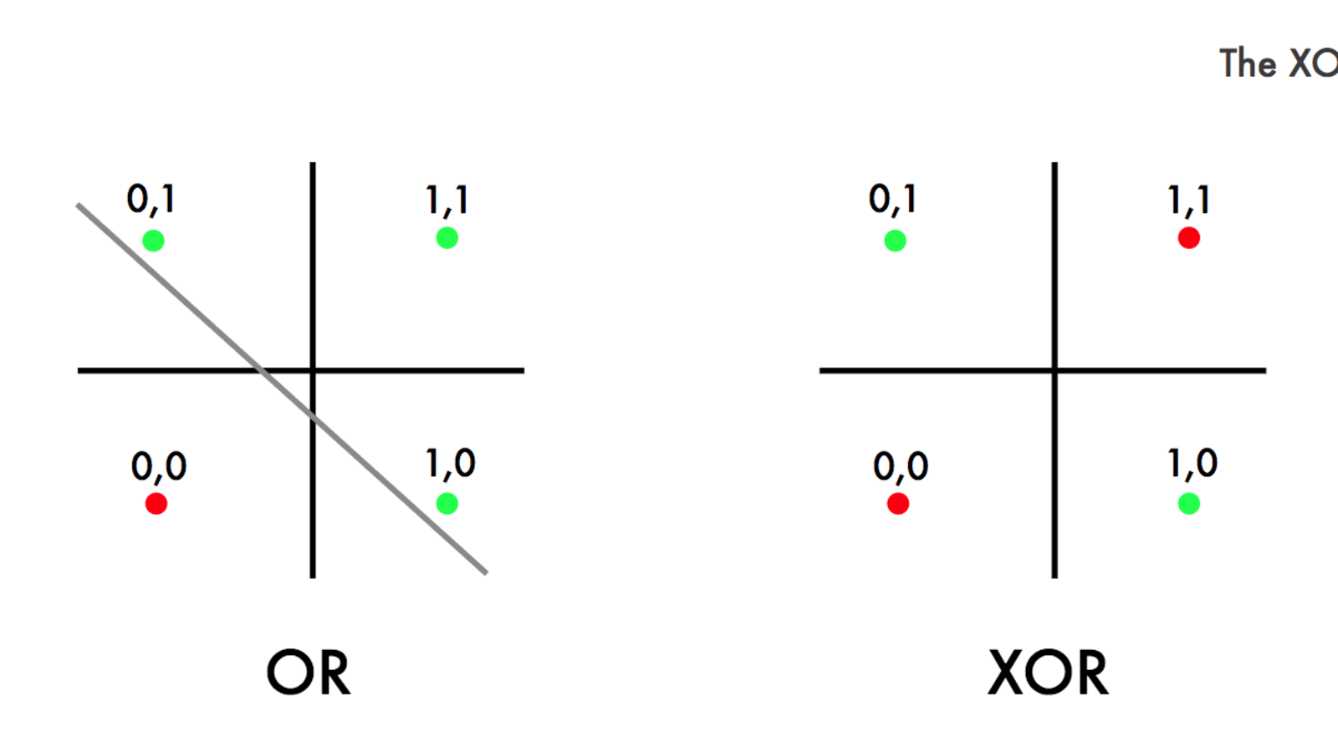
XOR problem with pytorch

Slide 8
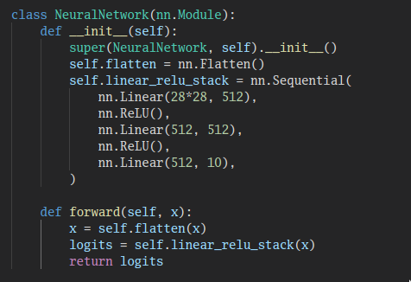
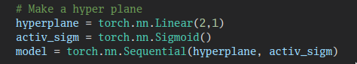
Build Neural Network
Legit
Bad

Slide 9
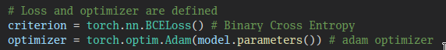
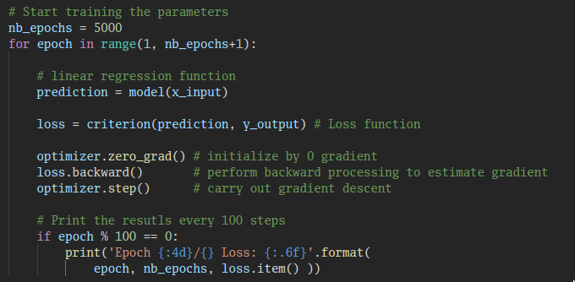
Optimization
Loss function and Optimizer
Training Loop

Slide 10
Image Classification Problems

Slide 11
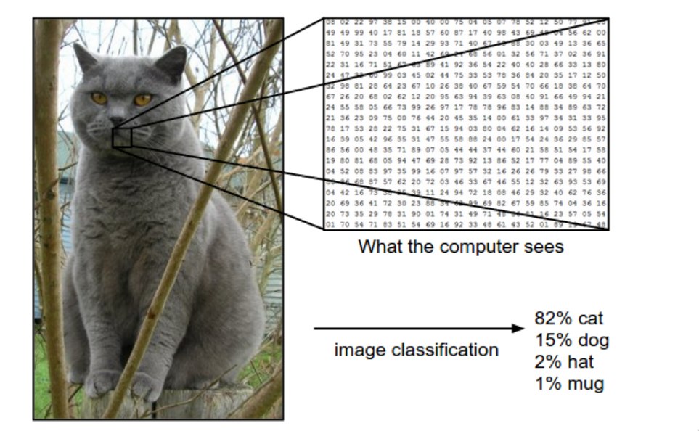

Slide 12
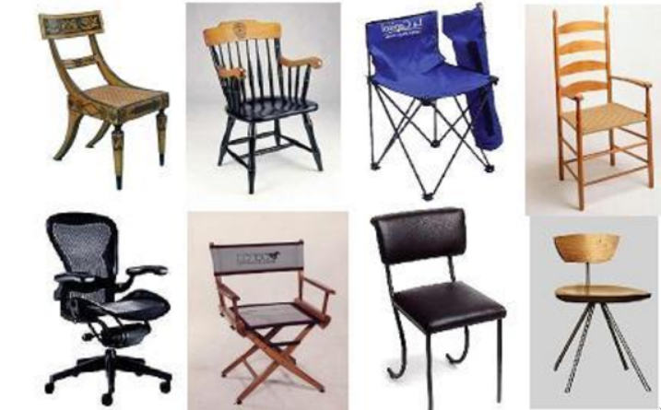
Challenges: Intra-Class Variation

Slide 13
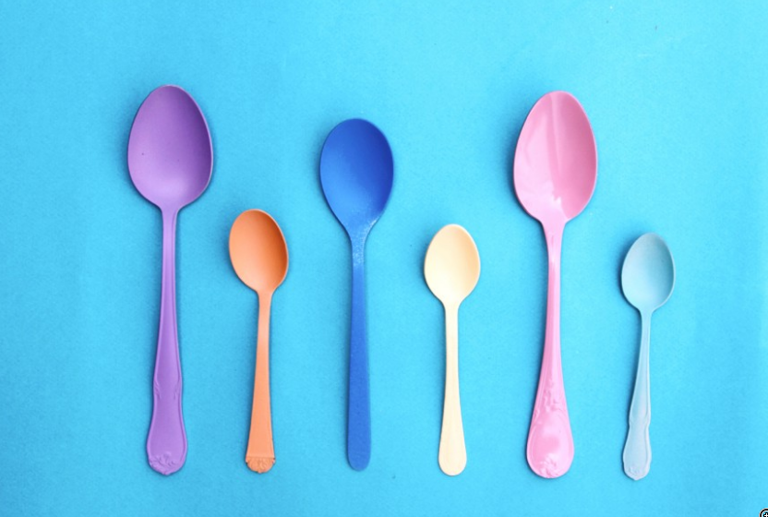
Challenges: Scale Variation

Slide 14
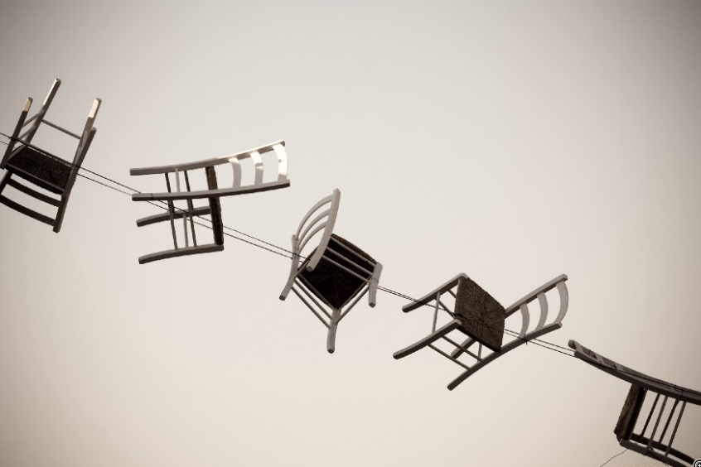
Challenges: Viewpoint Variation

Slide 15

Challenges: Occlusion

Slide 16
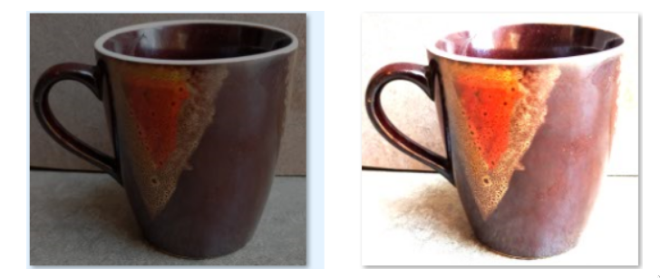
Challenges: Illumination

Slide 17
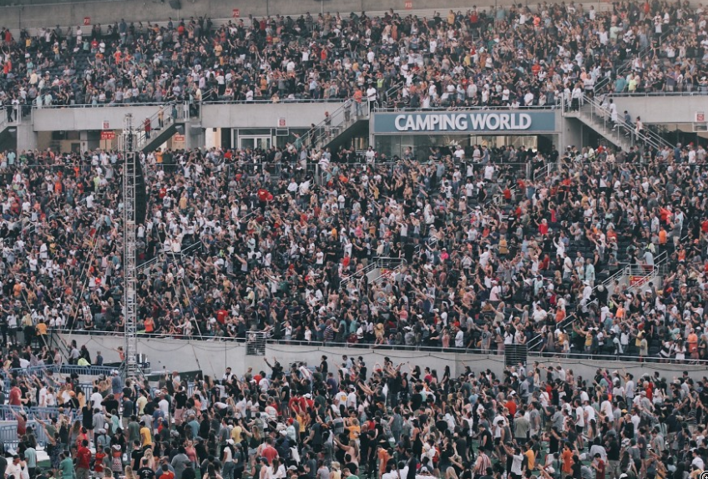
Challenges: Background Clutter

Slide 18
Flower Classification Dataset

Slide 19
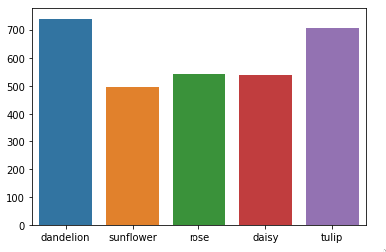
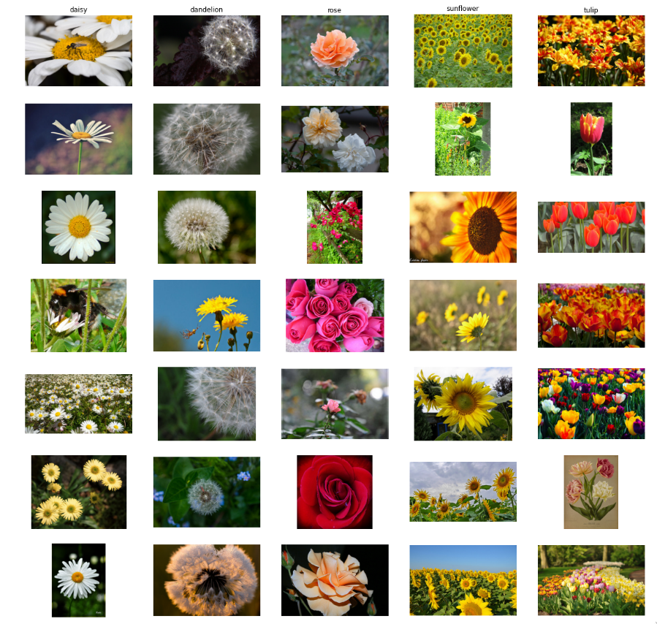
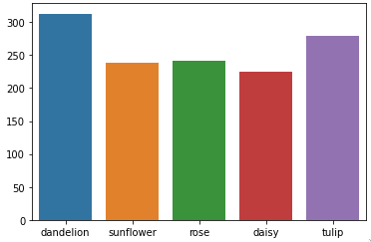
Train
Valid

Slide 20
Training Baseline

Slide 21
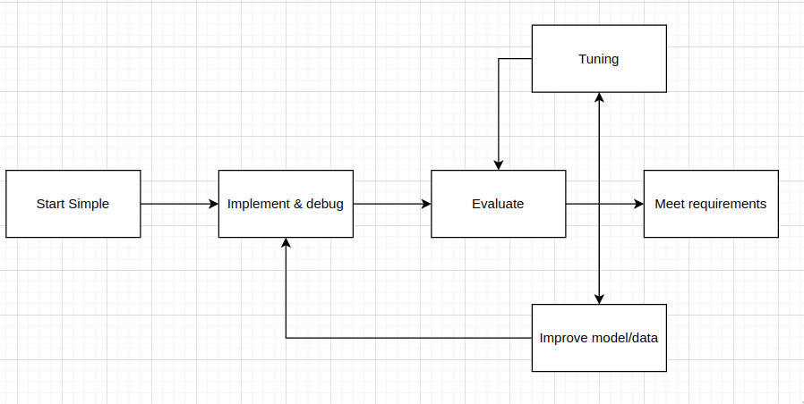
Full Training/Debugging Pipeline

Slide 22
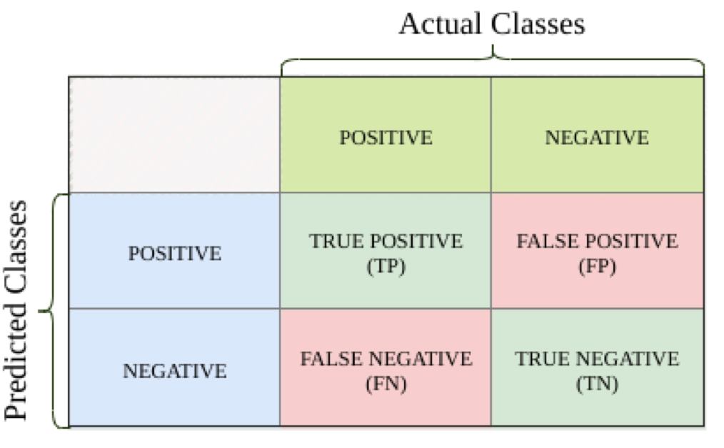
Evaluation Metrics

Slide 23
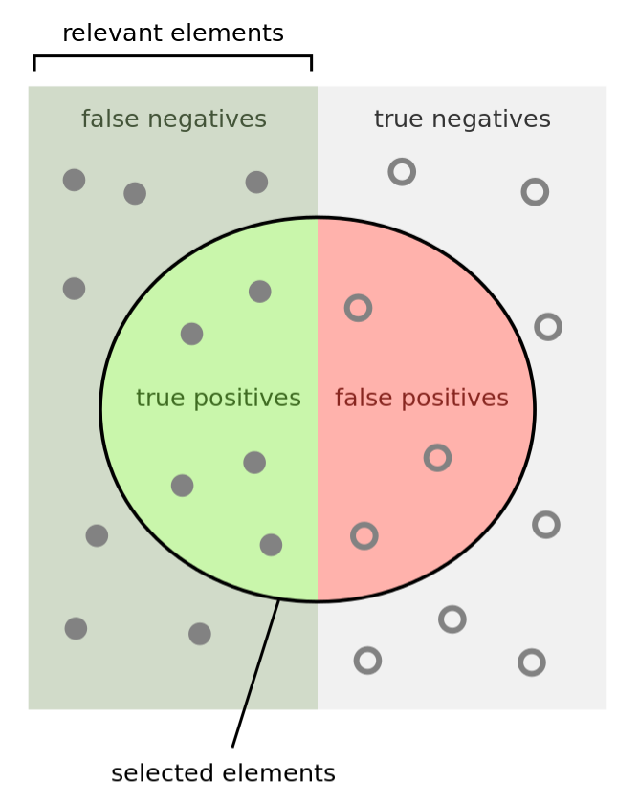
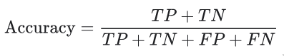
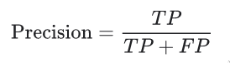
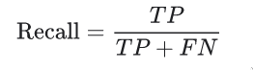
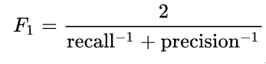
Evaluation Metrics

Slide 24
K Nearest Neighbors

Slide 25
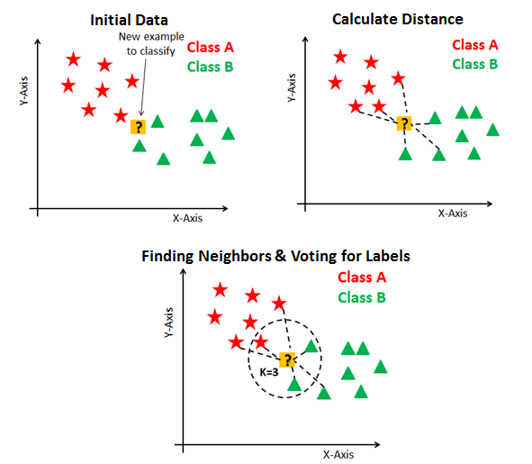
K Nearest Neighbors

Slide 26
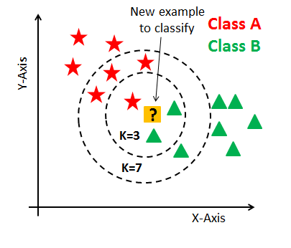
K Nearest Neighbors

Slide 27
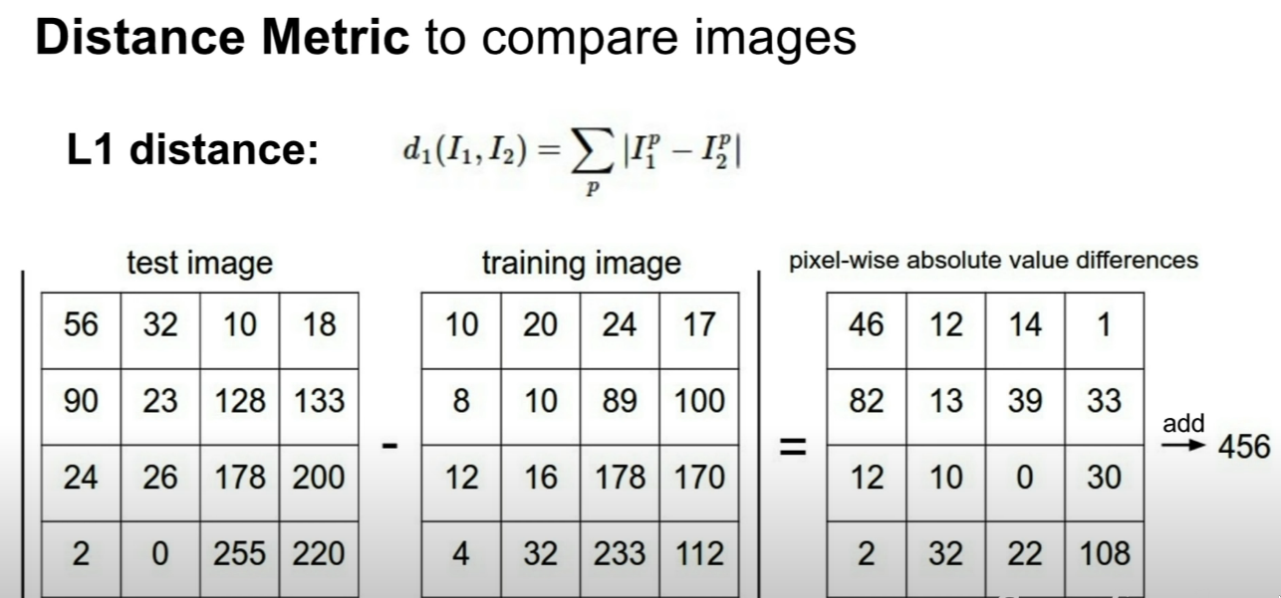
K Nearest Neighbors

Slide 28
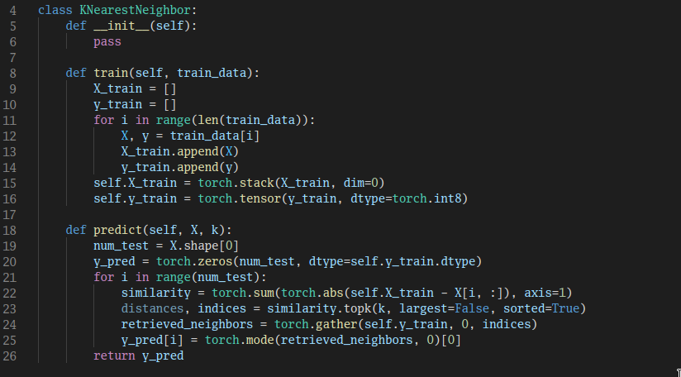
K Nearest Neighbors

Slide 29
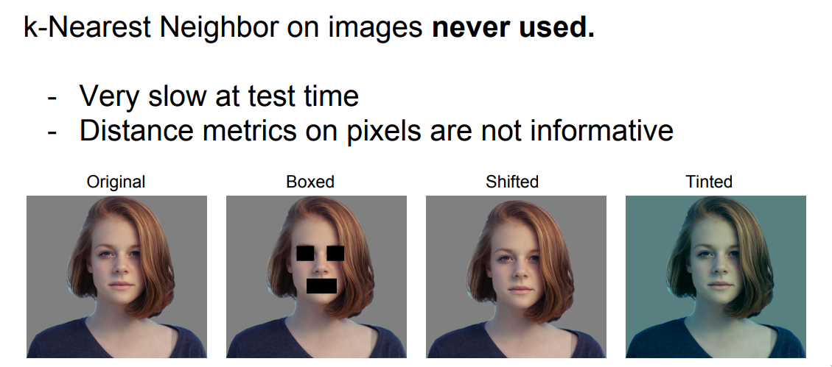
K Nearest Neighbors

Slide 30
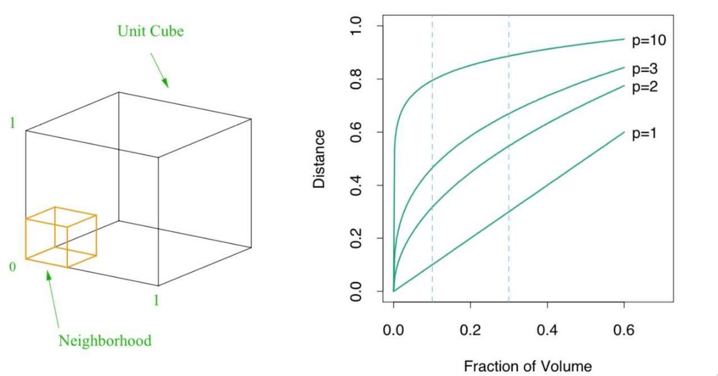
The Curse of Dimensionality

Slide 31
K Nearest Neighbors: Summary
In Image Classification we start with a training set of images and labels, and must predict labels on the test set
The K Nearest Neighbors classifier predicts labels based on nearest training examples
Distance metric and K are hyperparameters
Choose hyperparameters using the validation set; only run on the test set once at the very end!

Slide 32
Multi-layer perceptron

Slide 33
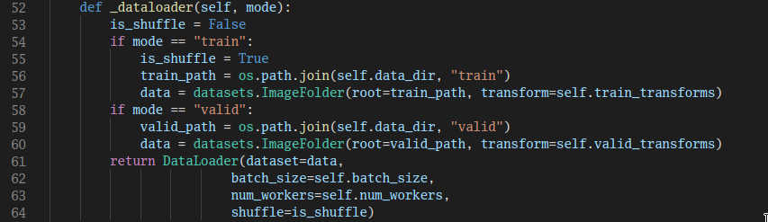
Flower Dataset & DataLoader

Slide 34
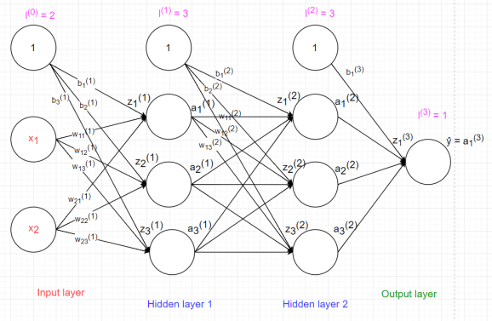

Slide 35
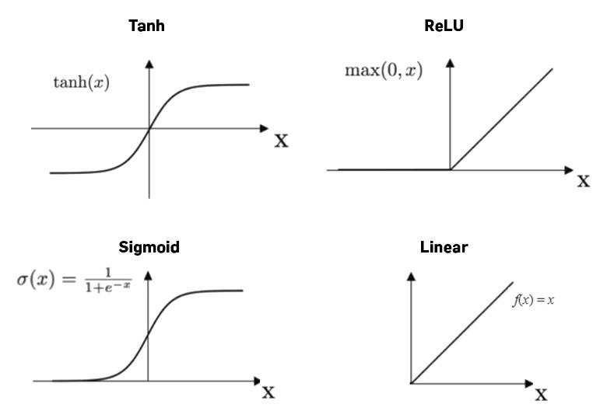

Slide 36
Advantages and Disadvantages
Capability to learn non-linear models.
Capability to learn models in real-time.
MLP with hidden layers have a non-convex loss function where there exists more than one local minimum.
MLP requires tuning a number of hyperparameters.
MLP is sensitive to feature scaling.

Slide 37
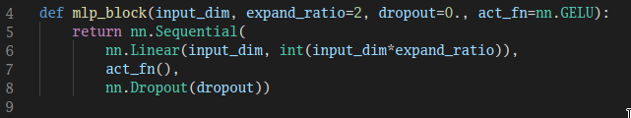
MLP Block

Slide 38
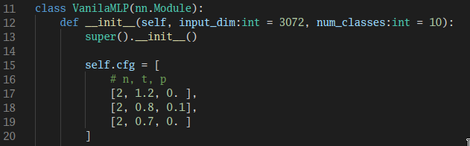
Model Configuration

Slide 39
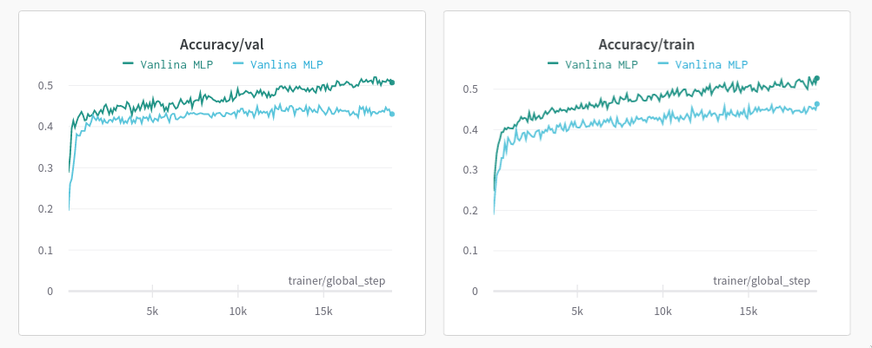
Experiments
Weight Initialization
More augmentations
Experiment with another activation functions

Slide 40
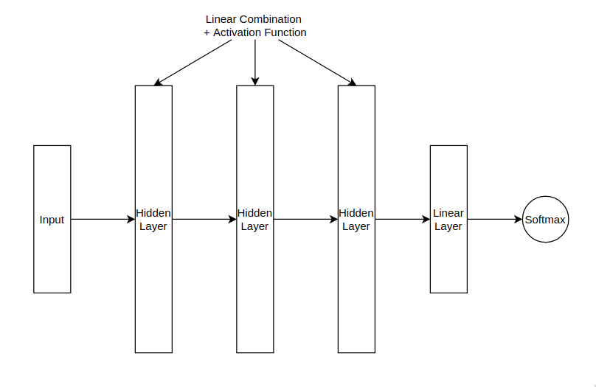
Using K-NN instead of Linear Classifier

Slide 41
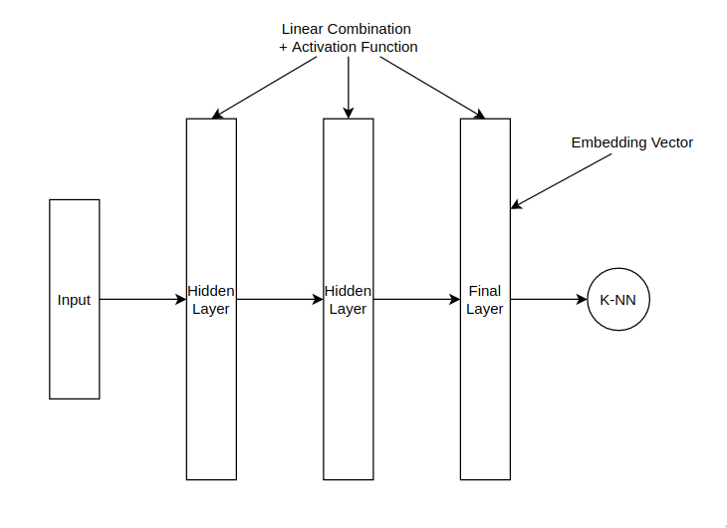
Using K-NN instead of Linear Classifier

Slide 42
Homeworks
Conduct experiments with different model configuration
Analyze the effect of activation functions

Slide 43
MLP mixer

Slide 44
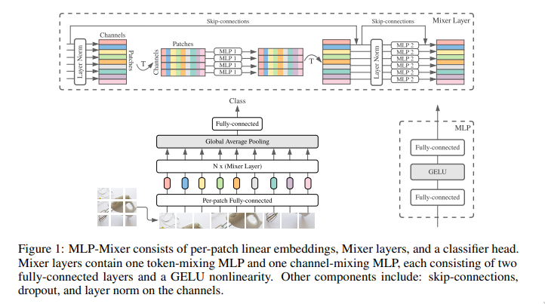
MLP-Mixer: An all-MLP Architecture for Vision

Slide 45
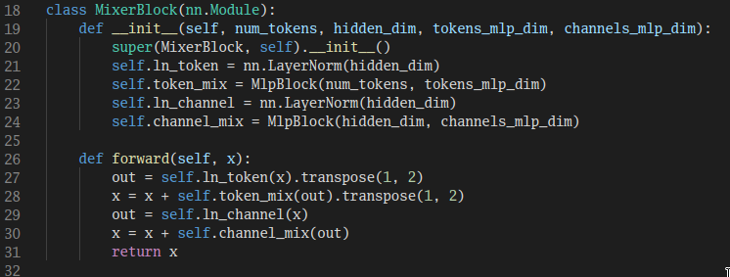
Mixer Block

Slide 46
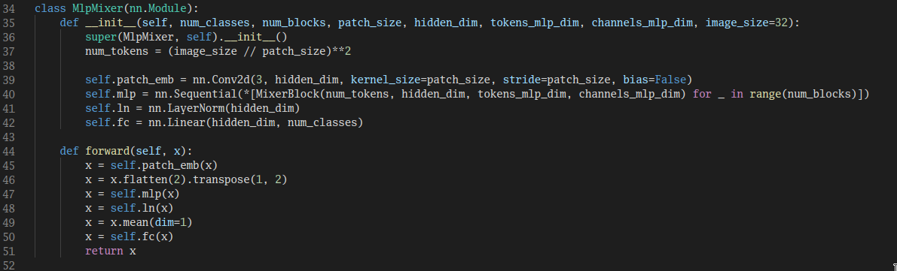
MLP mixer

Slide 47
What If?
Model without projection head
Shuffling the order of patches
Untying the parameters MLP
Replace LayerNorm with Affine Transformation

Slide 48
Homeworks
Conduct the shuffling experiment with CNNs
Visualize model weights

Slide 49
ResMLP

Slide 50
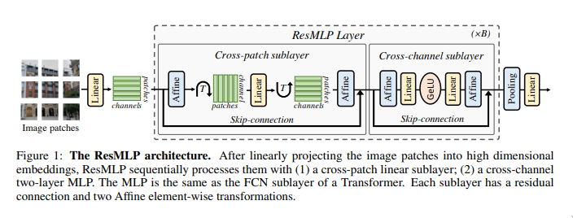

Slide 51
Analysis Tools

Slide 52
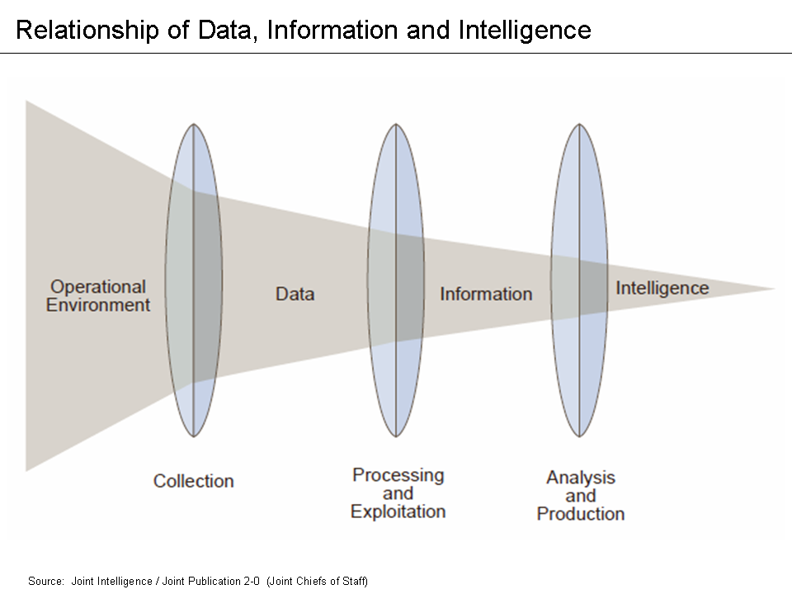
Data Analysis?
Data analysis is a process of inspecting, cleansing, transforming, and modelling data with the goal of discovering useful information, informing conclusions, and supporting decision-making.
Data analysis has multiple facets and approaches, encompassing diverse techniques under a variety of names, and is used in different business, science, and social science domains

Slide 53
What to analyze
Activation distribution
Weight distribution
Gradient distribution
Grad-CAM
Training process across experiments
Prediction results on train set, test set

Slide 54
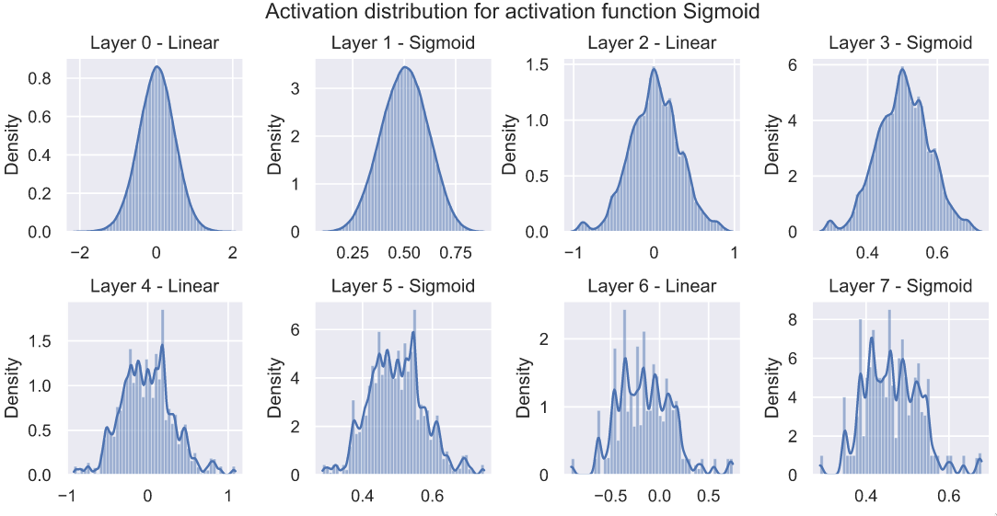
Activation Distribution

Slide 55
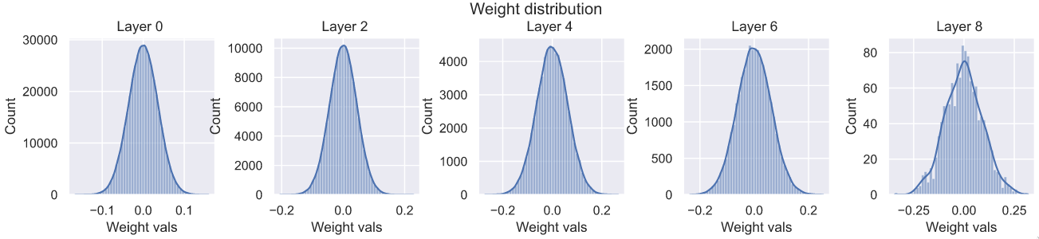
Weight Distribution

Slide 56
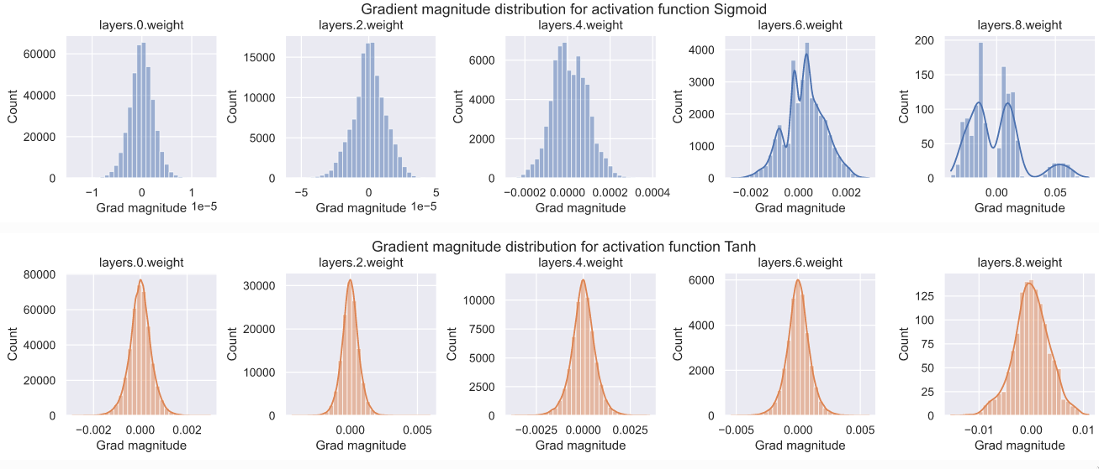
Gradient Distribution

Slide 57

Grad-CAM

Slide 58


Training processes

Slide 59

Analyze prediction results

Slide 60

Analyze prediction results

